Slide 1



Website Traffic Analysis:
Website traffic analysis is a fundamental practice for website owners, digital marketers, and businesses seeking to understand user behavior and optimize their online presence. This process involves collecting, analyzing, and interpreting data related to how visitors interact with a website. It provides valuable insights that inform decision-making, content strategies, user experience improvements, and marketing efforts.

Slide 2
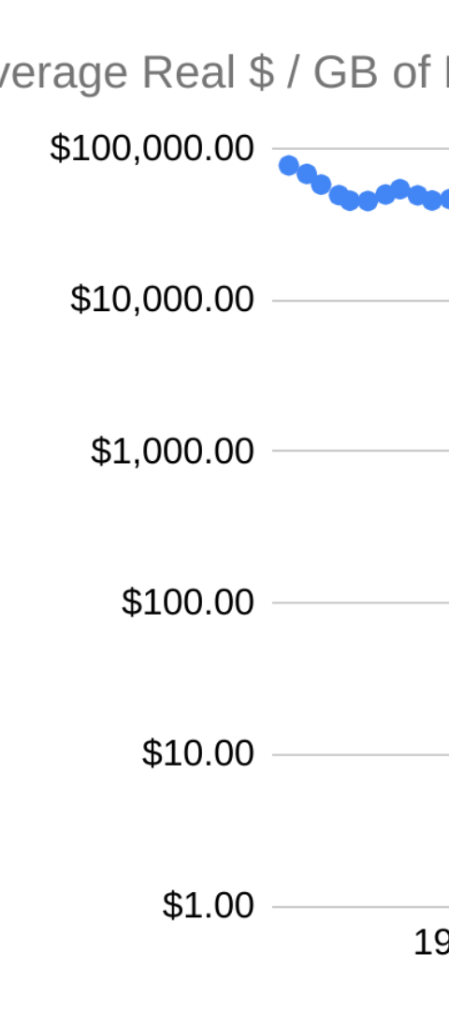
Defining Analysis Objectives
1
Identify Key Metrics
Define the specific metrics and dimensions you want to analyze to gain meaningful insights.
2
Determine User Behavior
Analyze click-through rates, bounce rates, and session duration to understand how visitors interact with your website.
3
Identify Popular Pages
Discover which pages attract the most visitors and optimize their content for enhanced engagement.

Slide 3

IBM Cognos: Data Visualization
1
Visualize Complex Data
2
Drag-and-Drop Interface
3
Data Storytelling
Create compelling narratives around your data, effectively communicating insights to stakeholders and decision-makers.
Leverage the power of IBM Cognos to create interactive charts, graphs, and dashboards that bring your data to life.
Easily design stunning visualizations without the need for complex coding or technical expertise.

Slide 4
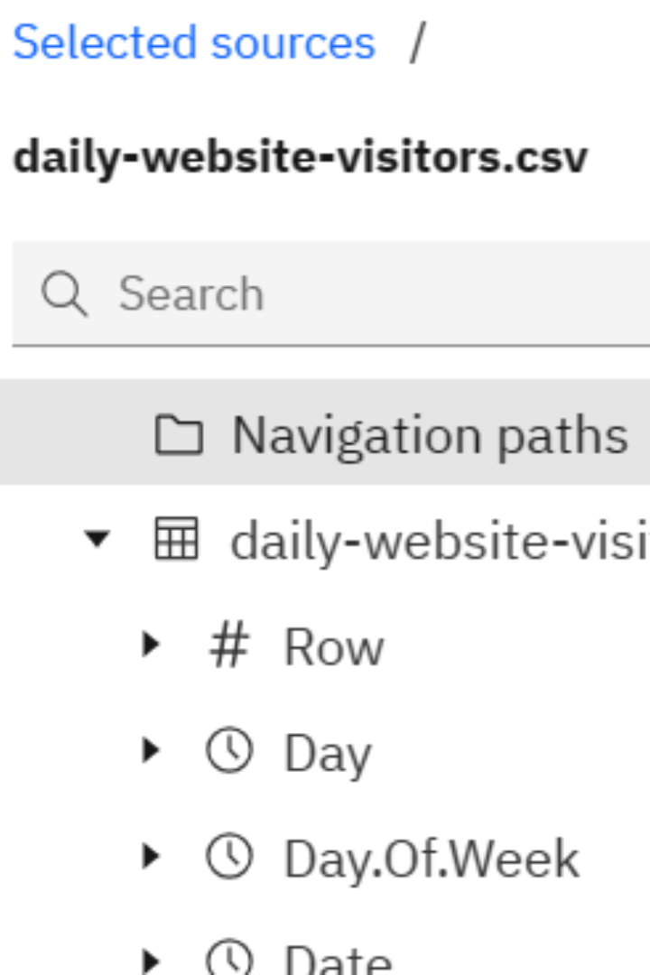
Overview of the given data(visualization)
The given data source file has been uploaded to the IBM COGNOS for the data visualization in an more template view. These visualization tool has been used to represent the data in an understandable way like in the format of graph, plots etc.

Slide 5
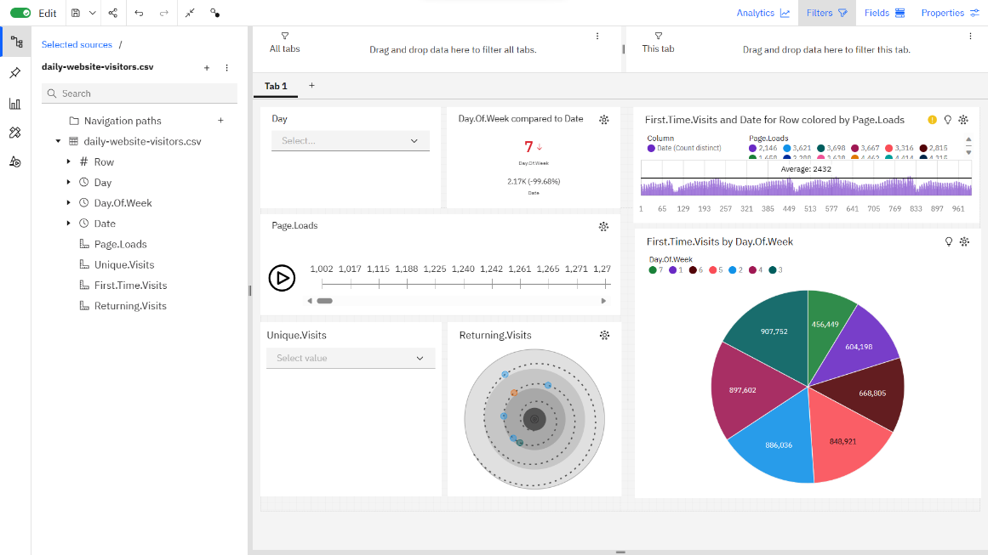
Dashboard (COGNOS)
The dashboard of the given data source file has been visualized using the tool IBM COGNOS for the more client pickup manner.

Slide 6
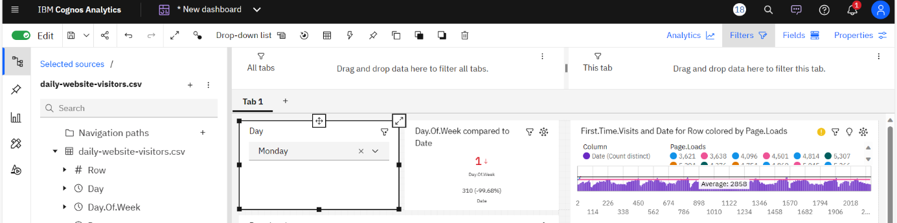
Visitors On Website
1)This visualization tell about the visitors are been enrolled on a specific
day for the website (Monday).
2)These visitors are compared with the day of week and with date
by the page loads. (tools:drawdown,linegraph,KPI)

Slide 7
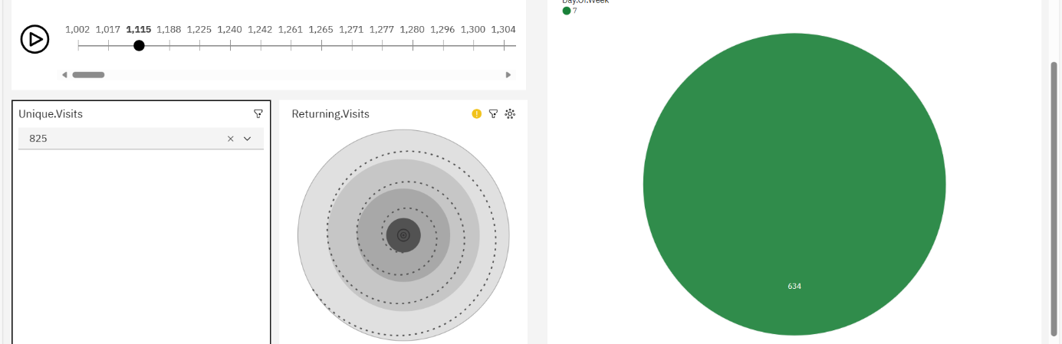
Unique, Returning Visitors
1)In this the tools are used to check the unique and returning visitors of the website.
2)This displays the unique visitors of the website number 825 in day of week is 7.

Slide 8

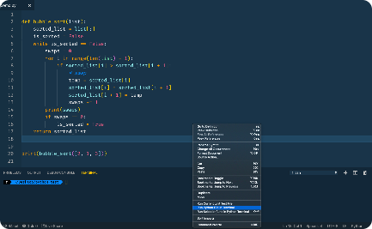
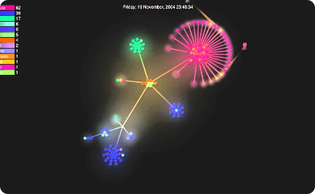
Advanced Analysis with Python
Data Science in Python
Custom Analysis Scripts
Data Visualization Libraries
Leverage the power of Python to perform advanced statistical analysis, machine learning, and data manipulation.
Write Python scripts to automate repetitive tasks, create custom visualizations, and tailor your analysis to specific requirements.
Utilize popular Python libraries such as Matplotlib and Seaborn to create stunning visualizations from your analyzed data.

Slide 9
Data Science in python
Analyzing website traffic is a common use case for data science, and Python is a popular choice of programming language for this task.
1)Data Collection: Kaggle is a popular online platform for data science and machine learning enthusiasts. Kaggle provides a range of services and features designed to support data scientists, machine learning practitioners, and researchers.
2)Data Preprocessing: Once you have collected the data, you need to preprocess it. This might involve cleaning the data, handling missing values, and converting data types.
3)Natural language processing: It is a subfield of data science and artificial intelligence that focuses on the interaction between computers and human language. NLP in Python involves using various libraries and tools to process, analyze, and understand text data.
4)Exploratory Data Analysis (EDA): It is a critical phase in the data analysis process, including website traffic analysis. EDA involves visually and statistically examining your data to understand its characteristics, detect patterns, and gain insights.

Slide 10
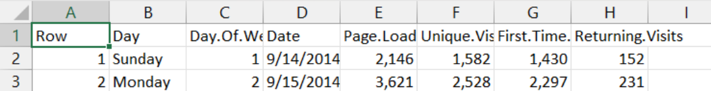
Data collection
The data is given from the project resource manager for the development of the website and making the analysis for making better calculations to the future builds.
The dataset is given with the link:
Project 1: Website Traffic Analysis Bookmark this page Project Title: Website Traffic Analysis
Dataset Link: https://www.kaggle.com/datasets/bobnau/daily-website-visitors
The dataset contains:

Slide 11
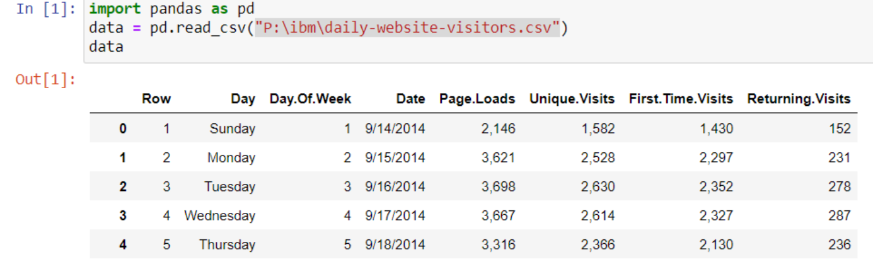
Data preprocessing
Data preprocessing is a fundamental step in the data analysis pipeline. . The primary purpose of data preprocessing is to improve the quality, consistency, and relevance of the data, making it easier to extract meaningful insights or to train accurate models.
Data cleaning:

Slide 12
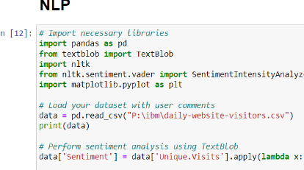
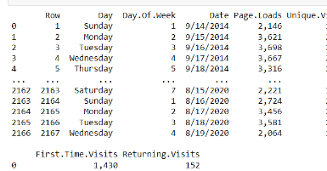
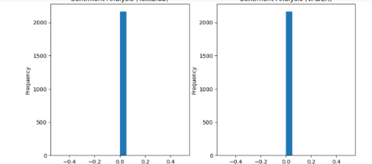
Natural language processing(NLP)
Natural Language Processing (NLP) in Python is a set of techniques and libraries used for the analysis, manipulation, and understanding of human language data. NLP is widely used in data analysis for extracting insights from unstructured text data, and it's particularly valuable in areas like sentiment analysis, etc.

Slide 13
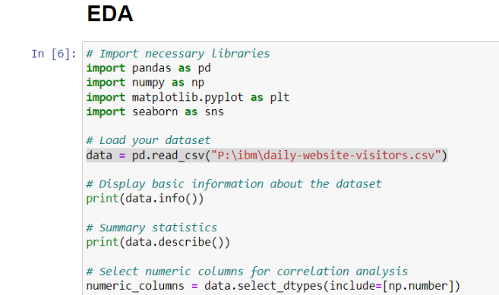
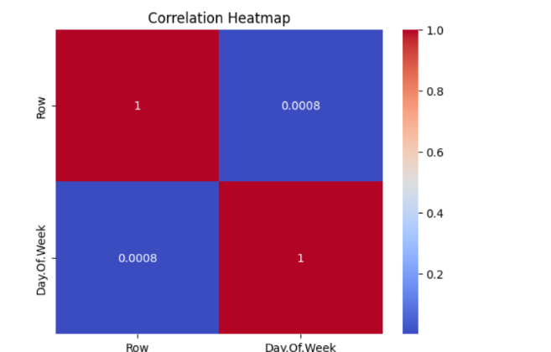
Exploratory Data Analysis (EDA)
Exploratory Data Analysis (EDA) is a preliminary step in data analysis that involves the systematic examination and initial understanding of your dataset. The primary goals of EDA are to identify patterns, detect anomalies, and gain insights into the data.

Slide 14

CONCLUSION
In conclusion, the website traffic analysis presented in this PowerPoint presentation sheds light on the essential insights and patterns that can be derived from the data. By exploring key metrics, such as pageviews, user engagement, and traffic sources, we have uncovered valuable information to drive informed decisions and optimize our online presence. The insights gained from this website traffic analysis will serve as a foundation for strategic decision-making, content optimization, and marketing efforts. By harnessing the power of data, we are better positioned to adapt to evolving trends, enhance user engagement, and achieve our goals.

